Slide 1
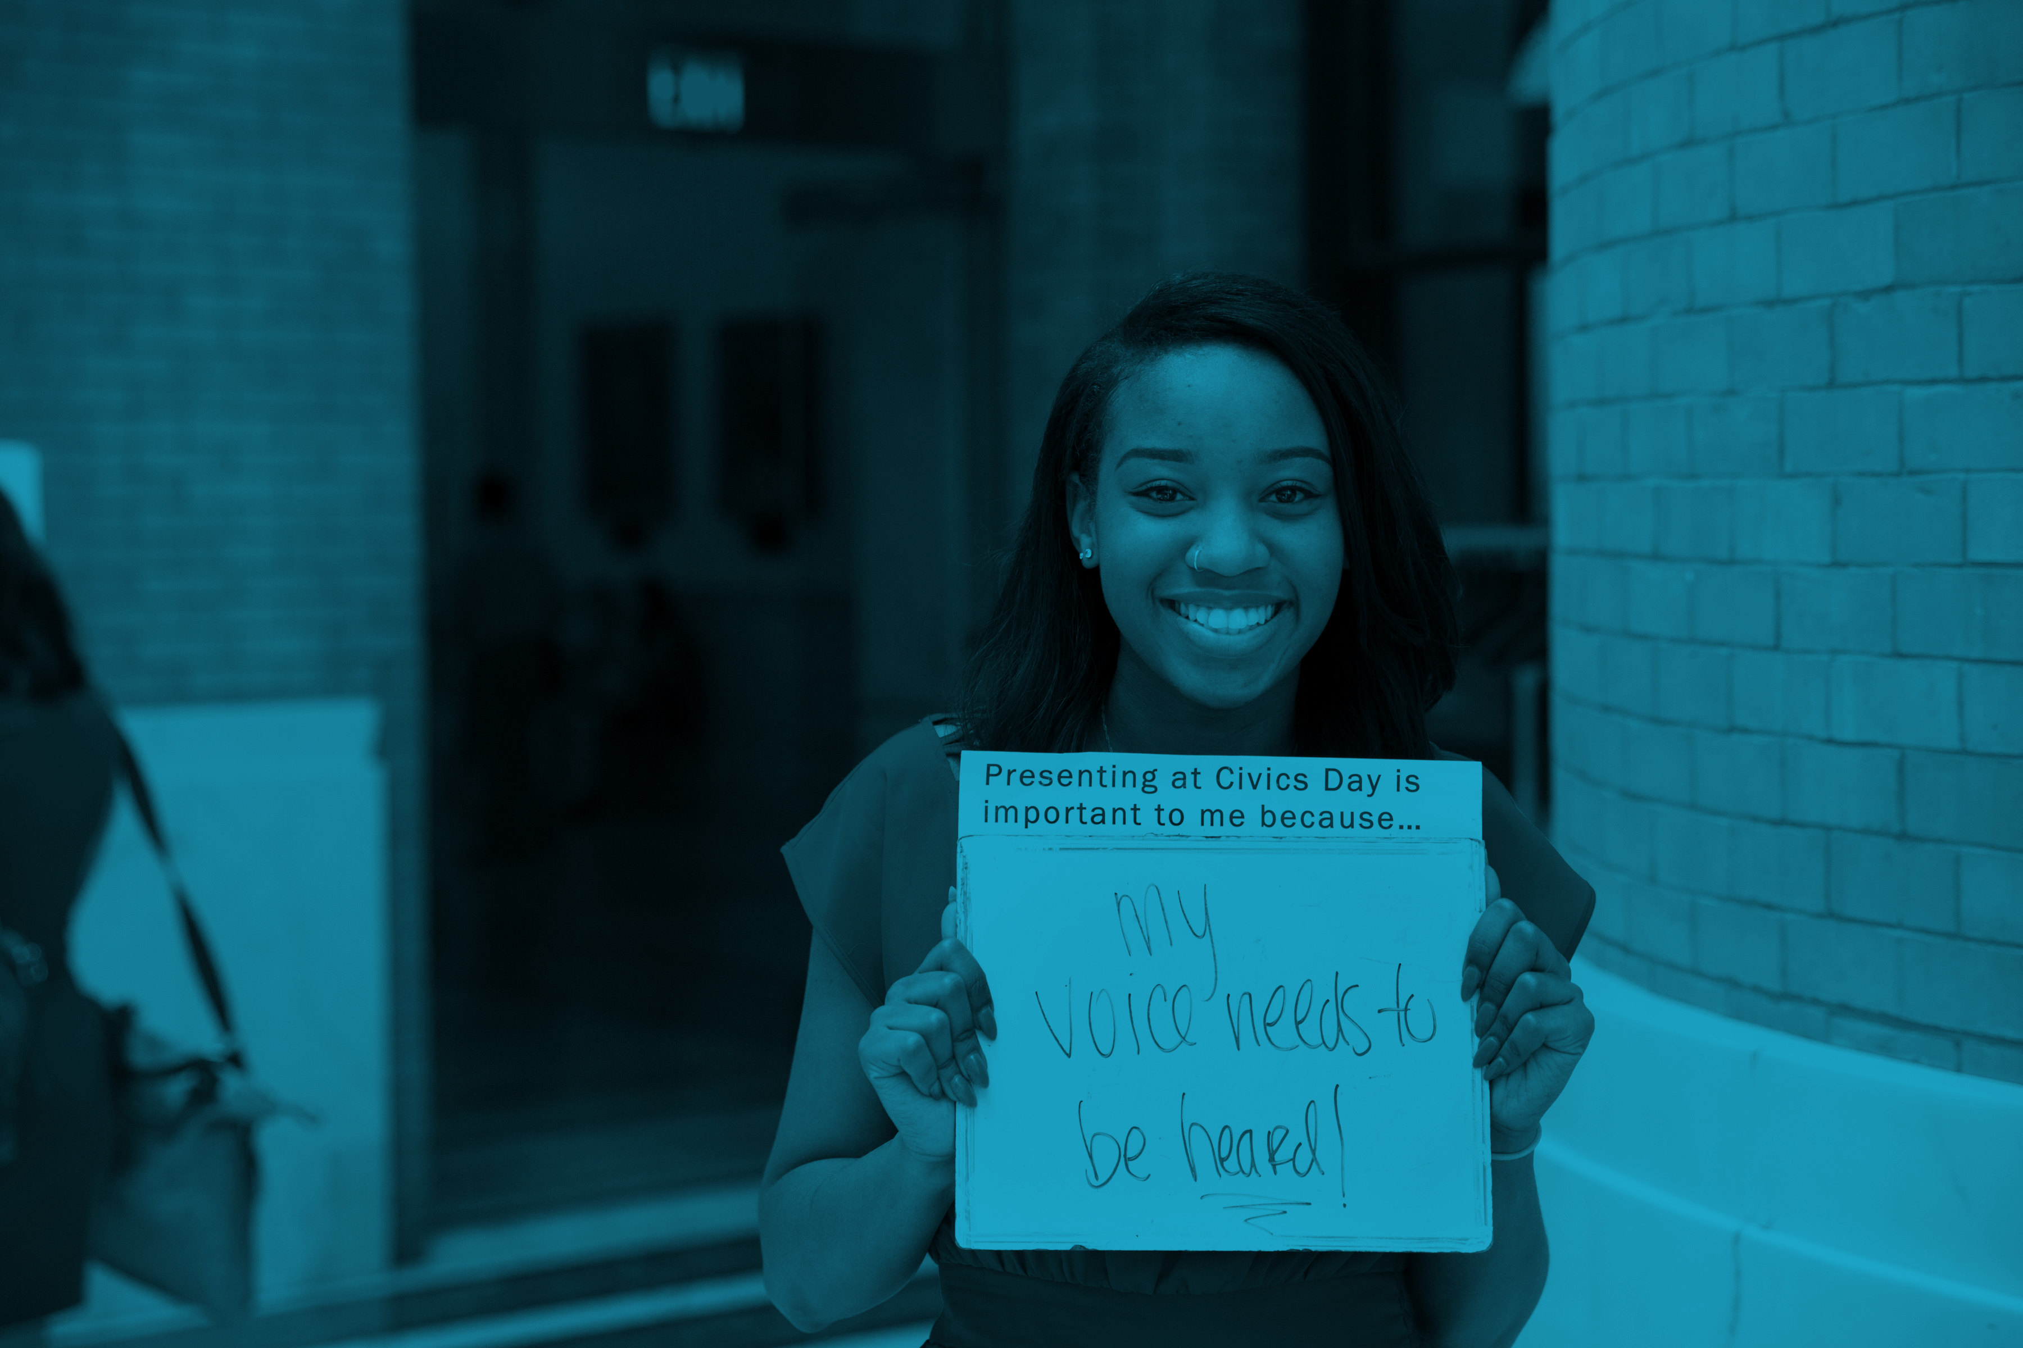

GENERATION CITIZEN:
Hack for Democracy
Notes:
Materials: Flipcharts labeled “Messages that resonate” “Your dollars will help” “Who?” “Outreach tactics?”

Slide 2
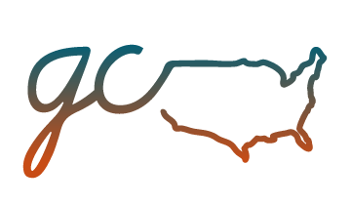
PROBLEM STATEMENT
Generation Citizen is working!
Our program is building student skills, knowledge, and motivation to civically engage, and is increasingly in demand among schools and teachers.
Generation Citizen is critical to our democracy!
Americans, and particularly young, low-income, and minority Americans, feel disconnected from their communities. They feel that their needs don’t matter to those in power. They look at the ugliness and gridlock in national politics and feel even more hopeless. This creates a vicious cycle in which Americans check out of politics and so it becomes even less likely to meet their needs. Generation Citizen breaks the cycle by reviving hope and motivating political agency.
Generation Citizen is struggling to make this case to donors!
Despite increasing student outcomes and growing recognition of Generation Citizen’s value, the organization still struggles in growing its fundraising. Here is where you can help!
Notes:
ADD IN STATS

Slide 3
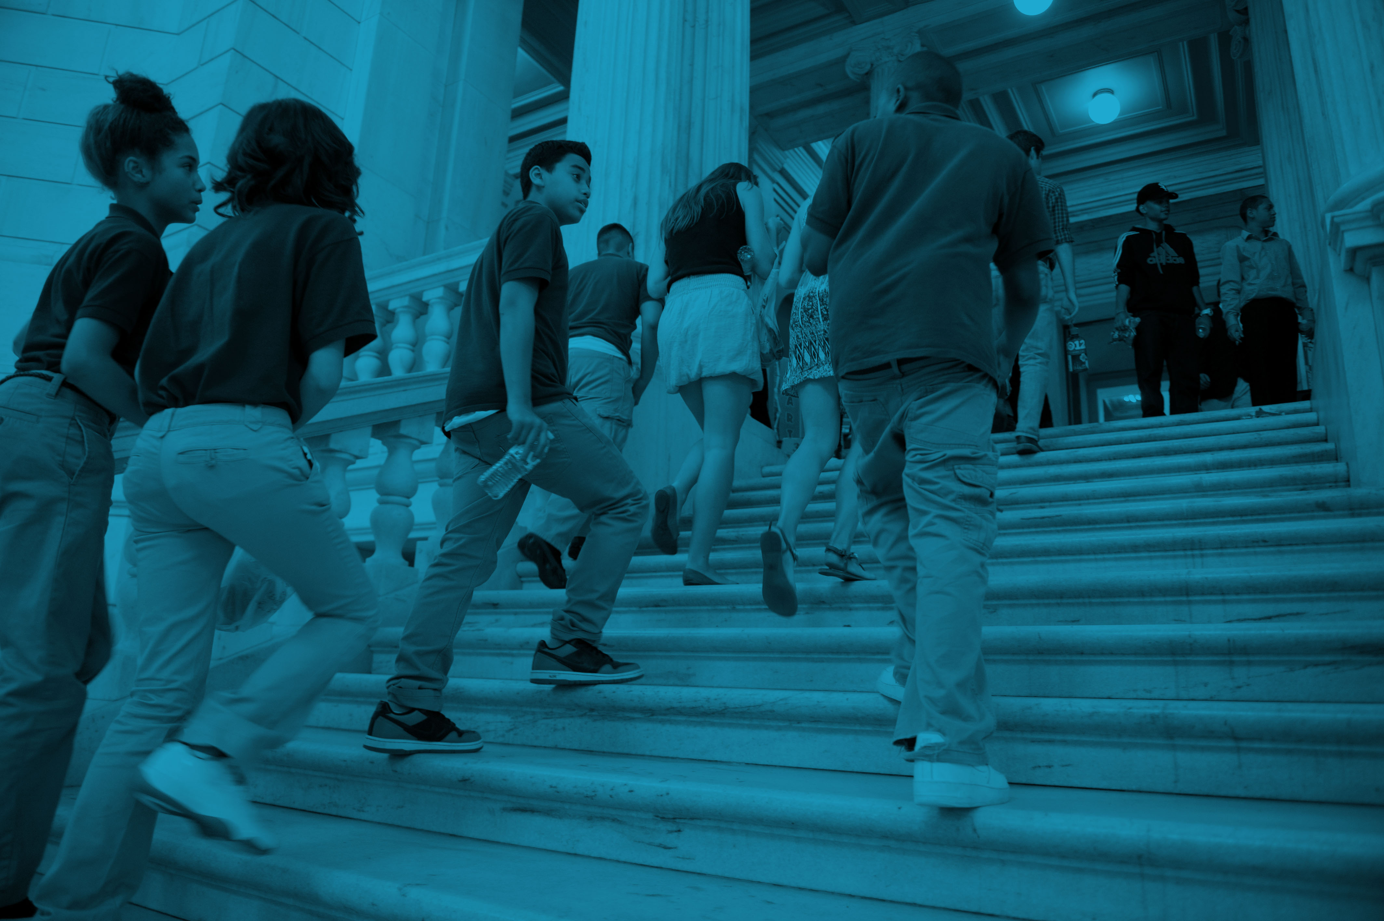
About Generation Citizen

Slide 4
Americans Are Turning Away From Political Participation
Notes:
Generation Citizen exists to address this country’s civic engagement crisis

Slide 5
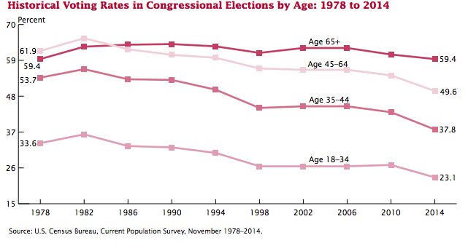
Especially…
Young people care about social change (half of millennials regularly volunteer) but they do not see political action as a way to make change
Notes:
Generation Citizen exists to address this country’s civic engagement crisis

Slide 6
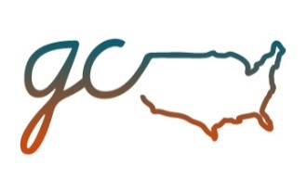
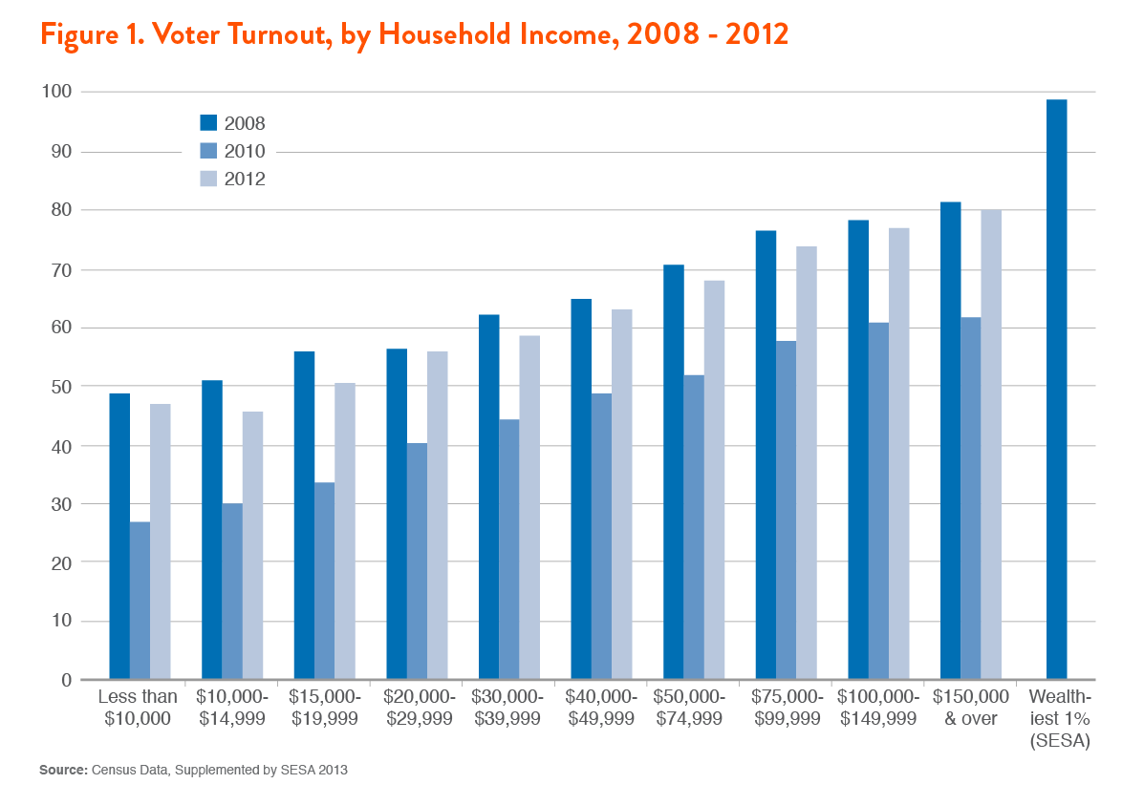
Especially…

Slide 7
A VICIOUS CYCLE
Populations do not participate
Government does not respond to the needs of these populations
Services are not provided
Populations (especially young, low-income, and minority Americans) feel disenfranchised

Slide 8
The Problem Starts in Schools
Civics has been pushed out of the curriculum, which means we are no longer taught how to be effective citizens.
The National Assessment for Educational Progress indicates that only 23% of 8th graders are proficient in civics – the worst result for any subject besides history.
If civics is taught, it typically involves rote memorization and not experiential learning, which is ineffective!
Nearly 70% of students never write letters to newspapers or otherwise express their opinions in a public way. Less than 20% of 4th or 8th grade teachers organize visits from members of the community, or report that their students participate in community projects.
Notes:
ADD IN STATS

Slide 9
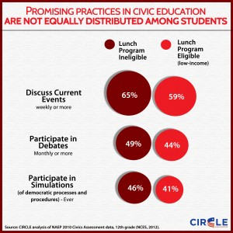
The Problem Starts in Schools
Civics education is unequal: low-income students are least likely to experience effective civics (and are, relatedly, least likely to vote or engage politically).
Notes:
ADD IN STATS

Slide 10
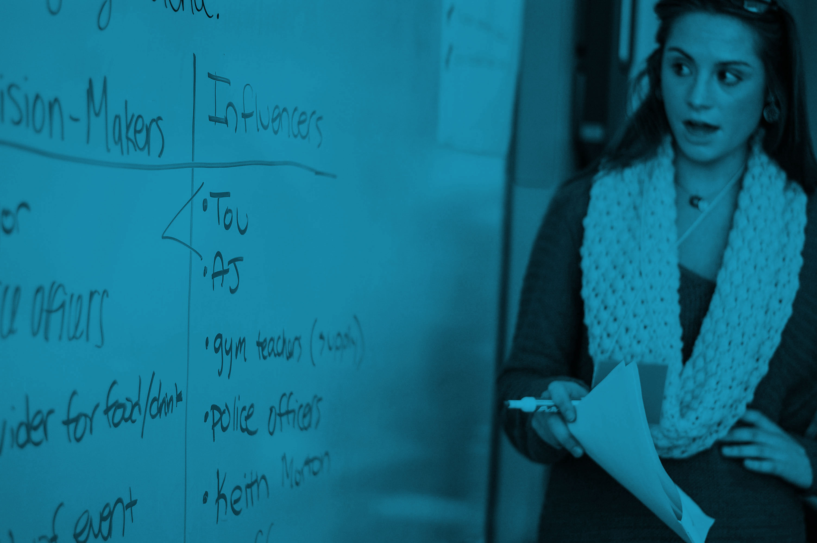
INTRODUCING… ACTION CIVICS
In schools, as part of the school day:
Students learn how democracy works by
utilizing government to take real action
on important community issues

Slide 11
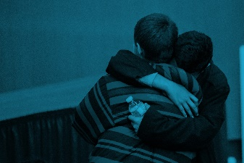
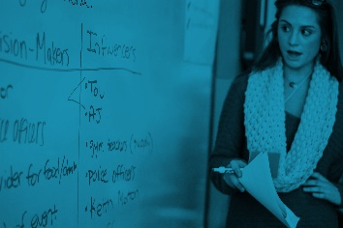
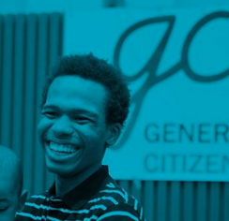
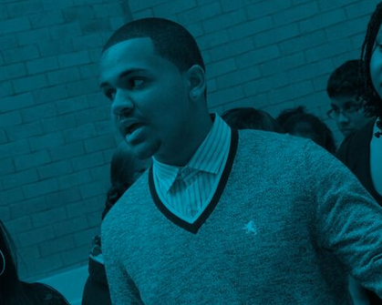
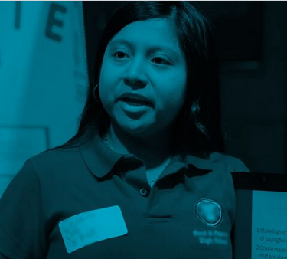
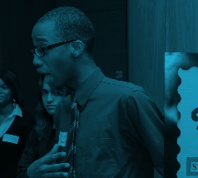
A Timeline of the Generation Citizen Classroom
Community Issues
Focus Issue
Root Cause
Goal
With support of teachers and college DEMOCRACY COACHES, students build consensus to choose a FOCUS ISSUE.
Targets
Students research and analyze to identify a POLICY-LEVEL SOLUTION.
Tactics
Students create an action plan using the ADVOCACY HOURGLASS framework.
Students gain the skills, knowledge, and motivation to be lifelong active citizens, and collectively build a new voice for politics.
Students launch REAL ACTION, in which they meet and speak with government and community leaders.

Slide 12
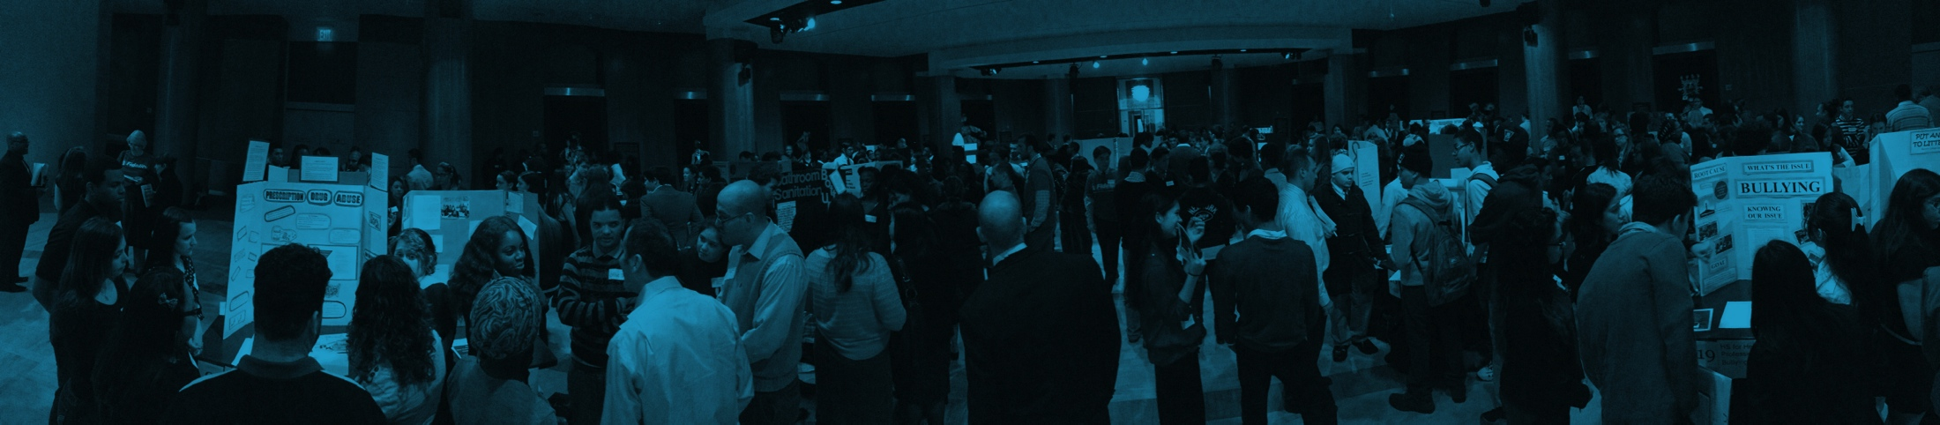
MISSION AND VISION
Generation Citizen works to ensure that every student in the United States receives an effective action civics education, which provides them with the knowledge and skills necessary to participate in our democracy as active citizens.
We envision a country of young people working
as active and effective citizens to collectively rebuild our American democracy.
Notes:
Stand when I read the part of the mission and vision that speaks most to you.

Slide 13
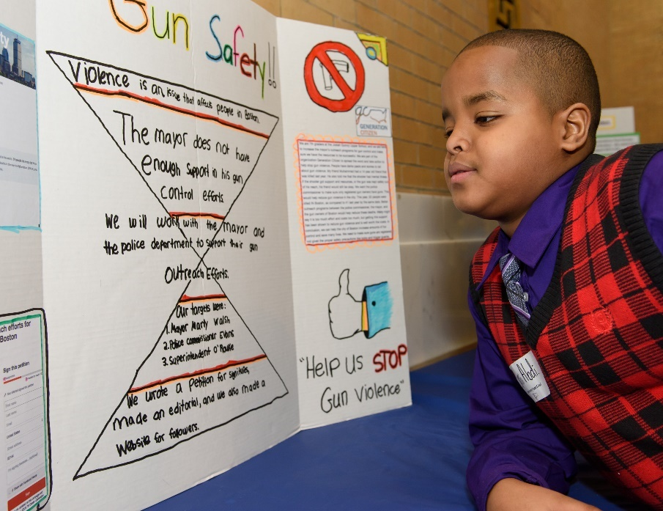
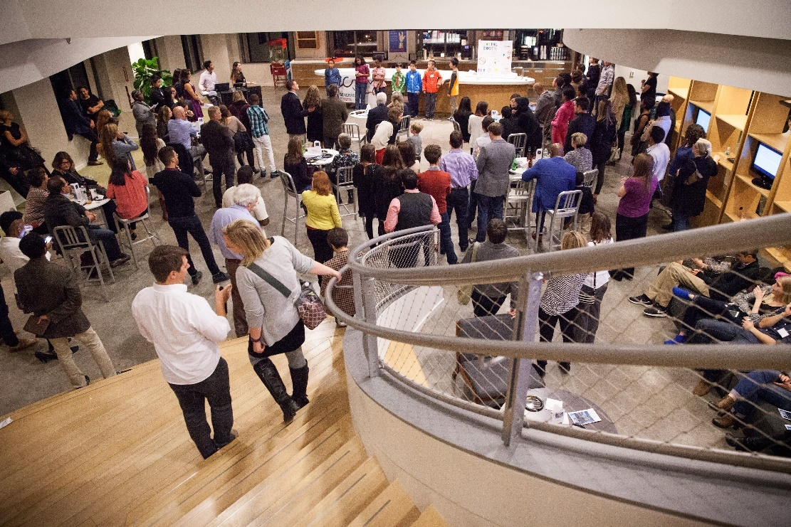
Theory of Change: Program & Demand Building
Action civics programs in partnership with local middle and high schools. In MA, we serve over 3,000 students per year.
Events, thought leadership, and policy to build demand for action civics action.
Notes:
ADD IN STATS

Slide 14
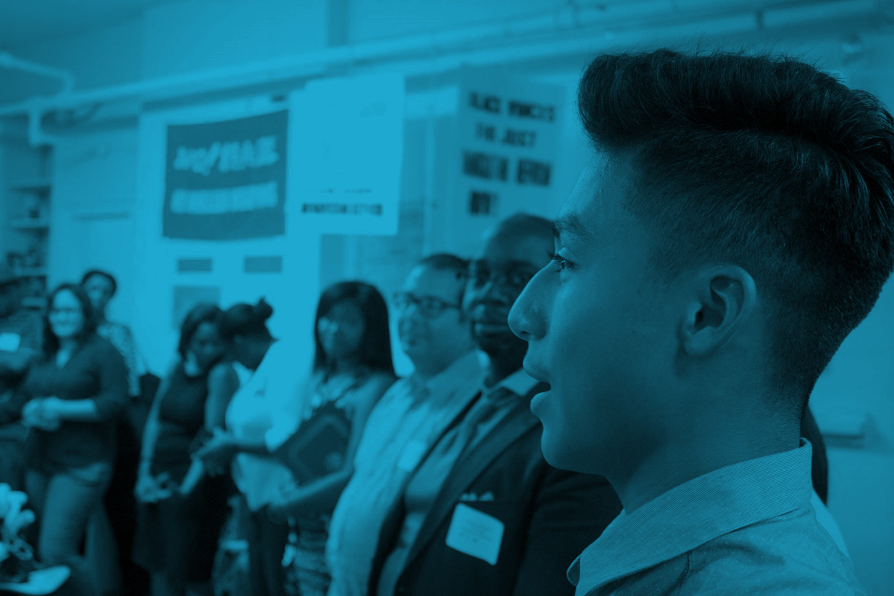
Hack for Democracy Food For Thought

Slide 15
PROBLEM STATEMENT
Generation Citizen is working!
Our program is building student skills, knowledge, and motivation to civically engage, and is increasingly in demand among schools and teachers.
Generation Citizen is critical to our democracy!
Americans, and particularly young, low-income, and minority Americans, feel disconnected from their communities. They feel that their needs don’t matter to those in power. They look at the ugliness and gridlock in national politics and feel even more hopeless. This creates a vicious cycle in which Americans check out of politics and so it becomes even less likely to meet their needs. Generation Citizen breaks the cycle by reviving hope and motivating political agency.
Generation Citizen is struggling to make this case to donors!
Despite increasing student outcomes and growing recognition of Generation Citizen’s value, the organization still struggles in growing its fundraising. Here is where you can help!
Notes:
ADD IN STATS

Slide 16

Goal: Boost GC’s Fundraising Messaging
How do we translate this into crisp talking points Board and staff can use in conversations?
How do we translate into newsletters and social media?
How do we be more “donor-centric” in our messaging, and make donors feel confident that their donations will deeply help the social problem?
How do we “pull on heartstrings” more in describing the social problem GC solves?

Slide 17

Appendix

Slide 18
OUR WEBSITE
WWW.GENERATIONCITIZEN.ORG
Notes:
ADD IN STATS

Slide 19
STATS 2-PAGER
https://drive.google.com/open?id=0B6gN1OzP1udYOUFnSVIwTDFZdFROV0t4RVljWXZEYnhoVEFV
Notes:
ADD IN STATS

Slide 20
Civic Skills
Oral persuasion
Written Persuasion
A classroom visits a State Senator and asks her to support a bill that would provide support for homeless families.
A student writes an op-ed arguing for an ordinance that would increase police accountability at traffic stops.
Group Collaboration
Critical thinking
A classroom of 8th graders divided between working on bullying and working on teen pregnancy talk it through and reach consensus to do teen pregnancy.
Students read an article about local gang violence and pull out the government structures and policies that might impact the presence of violence.

Slide 21
Civic Knowledge
Local Decision-Makers
How to Participate
A City Councilor visits a classroom and students learn who he is and how his office works with the Mayor.
An undocumented 8th-grader sees through her GC experience that even though she can’t vote, she can testify at a town meeting.
Individual vs. Community Root Causes
Branches and Levels
Students working on childhood obesity learn that responsible eating choices play a part, but that school lunch policies make it hard for kids to make better choices.
Students initially approach a City Councilor to talk about safety on the MBTA, and learn that they need to talk to a state-level department instead.

Slide 22
Civic Motivation
Civic
Efficacy
Civic
Responsibility
Students meet with a State Senator and expect him to dismiss their arguments – and are surprised to find how much he listened.
Students knew that veterans in their community were struggling, but after learning how bad veteran poverty was through GC, they realized they need to do something.
Leadership
Potential
Grit
A guest speaker from an organization that advocates for clean energy came into a class and described how long the fight has been – they’ve made good changes, but it’s taken years.
One student loves to argue and is considered a “problem student.” But in GC, he pushes the class to more passionate arguments. His class chooses him to represent them at Civics Day.

Slide 23
Community Impact
Teen Violence
Music Education
Students in Malden successfully lobby for a city budget line-item that builds a teen center in their community and helps keep youth out of trouble.
Students in Boston help stop a state bill that would cut funding for school music programs across the state.
Sustainability
Opioid Crisis
Students in Boston help pass a city ordinance that institutes single-stream recycling in Boston Public Schools, greatly improving school recycling.
Students in Lowell work to institute a successful policy from Gloucester that would allow addicts to go to police to be referred to treatment.

Slide 24
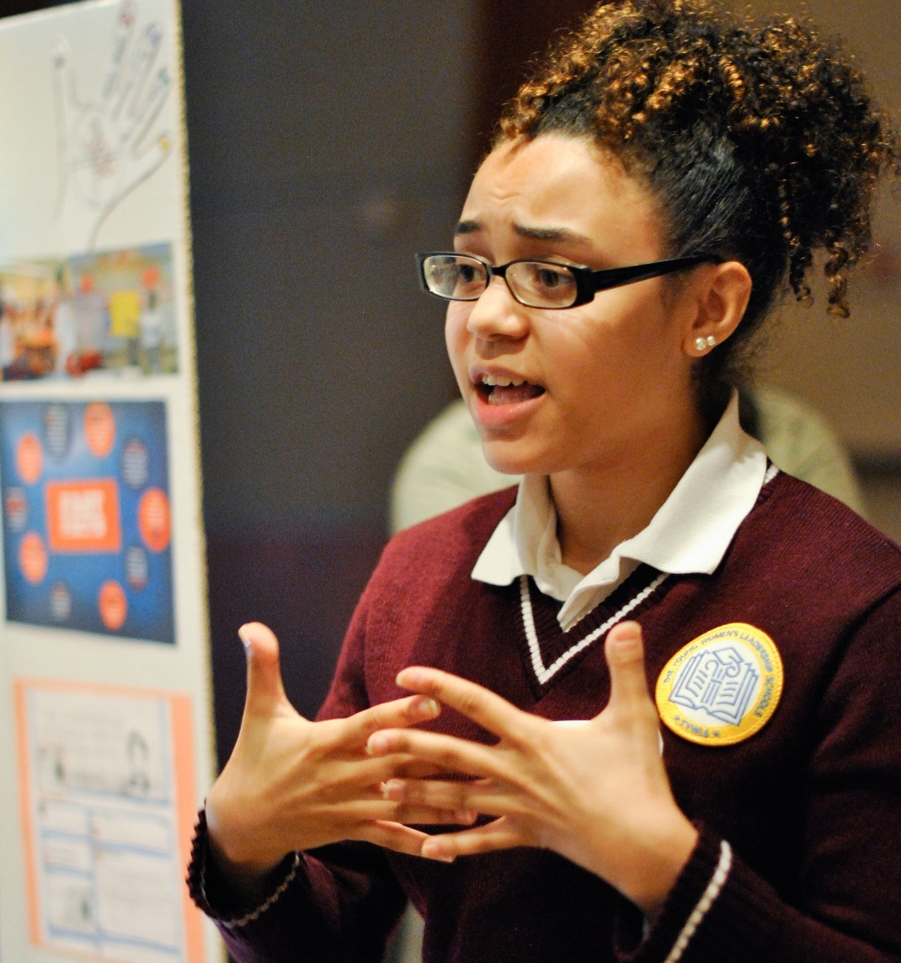
A WORKING POLITICS
“The most valuable lesson I learned was that it’s not the government making decisions for us, it’s people pushing them to make decisions.”
Jacqueline Thorn, GC Student

Slide 25

CONSTRUCTIVE DIALOGUE
“I have learned how to persuade people with opposing beliefs. I am entirely grateful for this because I will spend the rest of my life working with people who may not agree with me. We all will. Which reminds me of another skill [GC] taught me…patience.”
Michael O’Keefe, GC Student

Slide 26
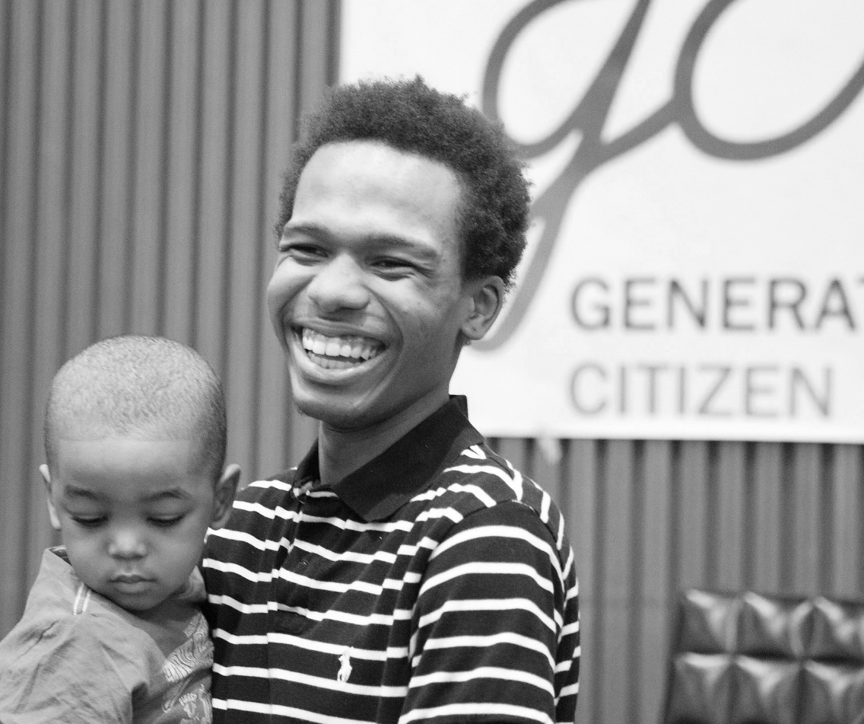
“I never understood that my problems and the problems of my friends really mattered to the rest of society. I just assumed that nobody cared. Working with Generation Citizen made me realize that my opinion matters to people in power.”
HOPE & AGENCY
De’Anthony Robinson, GC Student

Slide 27
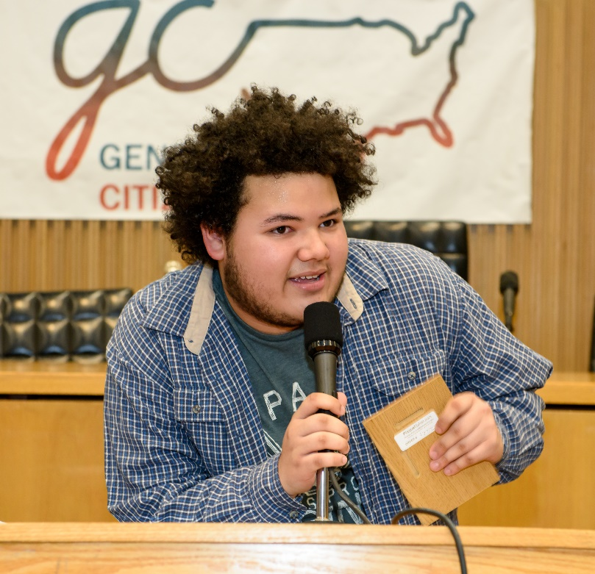
CIVIC RESPONSIBILITY
“The youth are just as part of the community as anyone else, and we must participate and engage in political change. At the end of the day, we’re the future of Boston and the cities we each come from, and it’s important that we keep our communities thriving.”
Brian Foster, GC Student
Notes:
Video?

Slide 28
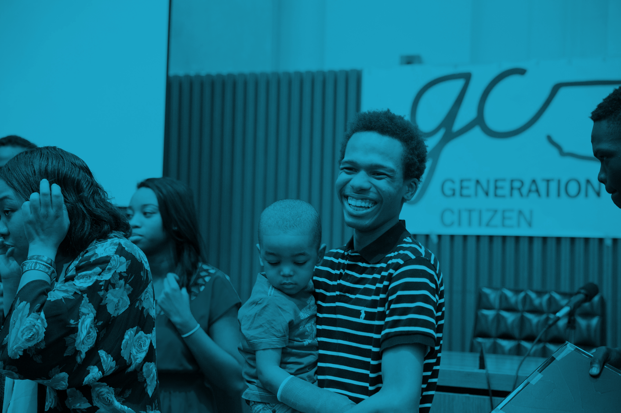
THANK YOU!

